Slide 1

Data Warehousing Project
GROUP 4: Technocratic Dynamos
Ankit Arun Patil A20451742
Daphney Carol A20446937
Divya Poojari A20446668
Neha Desai A20402675
Tanmay Deepak Patil A20439531

Slide 2
Data Sources
Data 1: State wise data related to Covid -19 for all states across the US.
This data gives information on Covid from 25th March 2020 to 26th April 2020
https://aws.amazon.com/blogs/big-data/a-public-data-lake-for-analysis-of-covid-19-data/
Data 2: Global data for all countries around the globe.
This data gives information on Covid-19 recovered patients from January 2020 to April 2020
https://github.com/CSSEGISandData/COVID-19/blob/master/csse_covid_19_data/UID_ISO_FIPS_LookUp_Table.csv

Slide 3
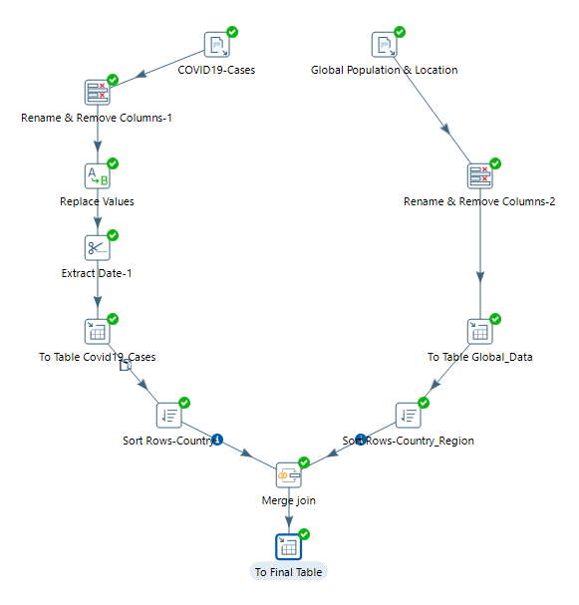
ETL using Pentaho
Covid19_Transformation
Datasets used:
Date Wise csv files
It comprises of deaths, confirmed and recovered cases globally.
UID_ISO_FIPS_LookUp_Table.csv
It provides population and its latitude and longitude details of all the states affected by COVID19 globally.

Slide 4
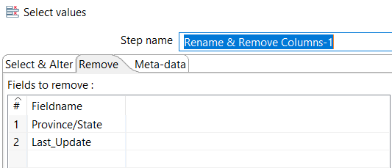
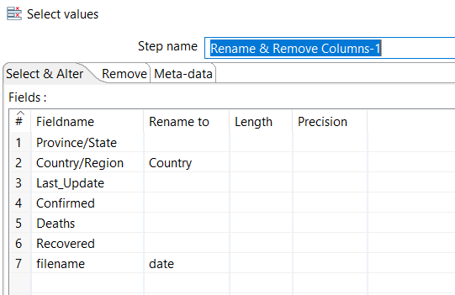
Data Preprocessing
Renamed columns.
Using the “select values” component, we have renamed fields from select & alter tab.
Removed columns
Using the ‘select values’ components we have removed fields from Remove tab.
Notes:
1. Data Preparation / Provisioning
▪ ETL Implementation to streamline source extract / transform
▪ Data modeling (normalization / denormalization) if applicable
▪ Diversity of data points available for reporting"

Slide 5
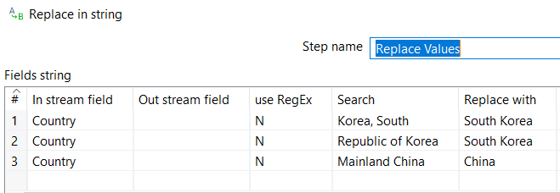
Data Preprocessing
3. Using the ‘Replace in String’ component we have replaced certain values from the field ‘Country’.

Slide 6
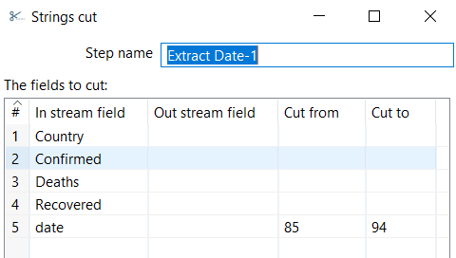
Data Preprocessing
4. Using the ‘Strings Cut’ component we have extracted ‘date’ from the timestamp.

Slide 7
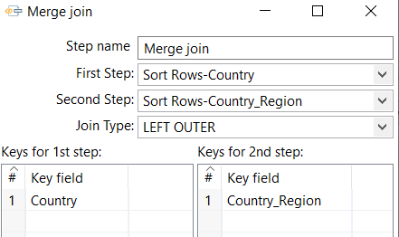
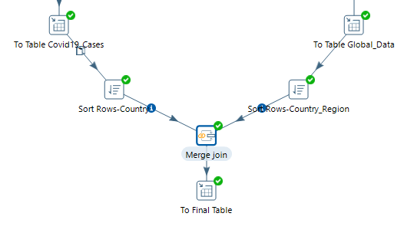
We have performed Left outer join on the key field ‘Country’ and ‘Country_Region’ as shown below.
Output Table: Global_Covid19_Cases

Slide 8
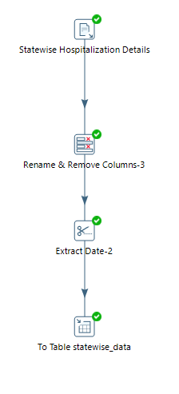
Dataset used:
State_daily.csv
It provides state wise information about the hospitalization, ICU and ventilator usage as well as number of cases tested positive and negative in US.
Data Preprocessing is performed same as before.
Output Table: statewise_data

Slide 9
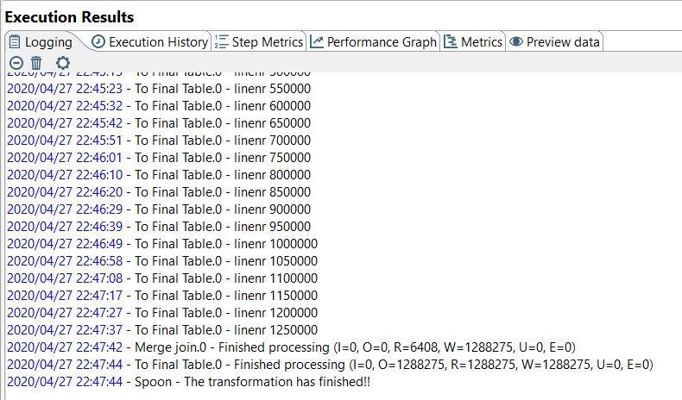
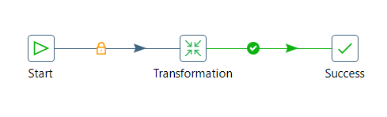
Job referencing the transformation has been executed successfully.

Slide 10
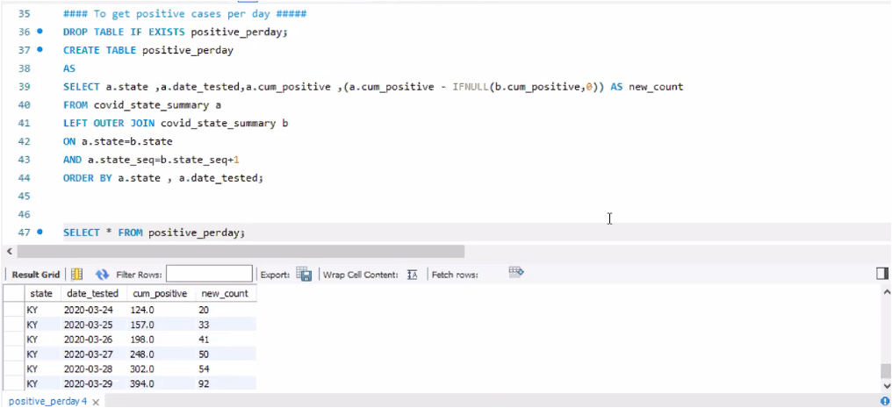
SQL Queries for visualization
Story 1: Positive covid-19 cases reported on daily basis across all states in the US
SQL query: To get positive cases for every single day

Slide 11
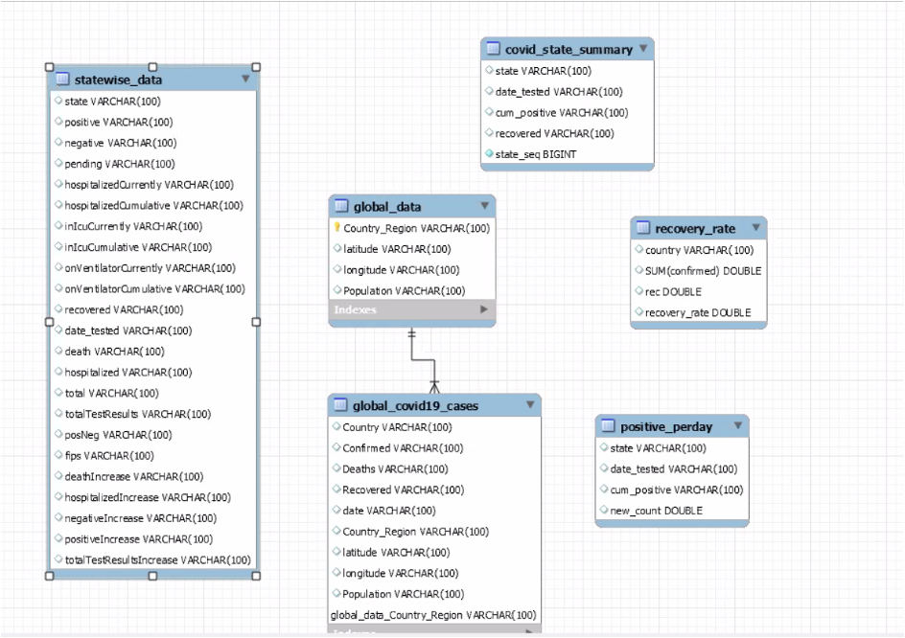
Data Model

Slide 12
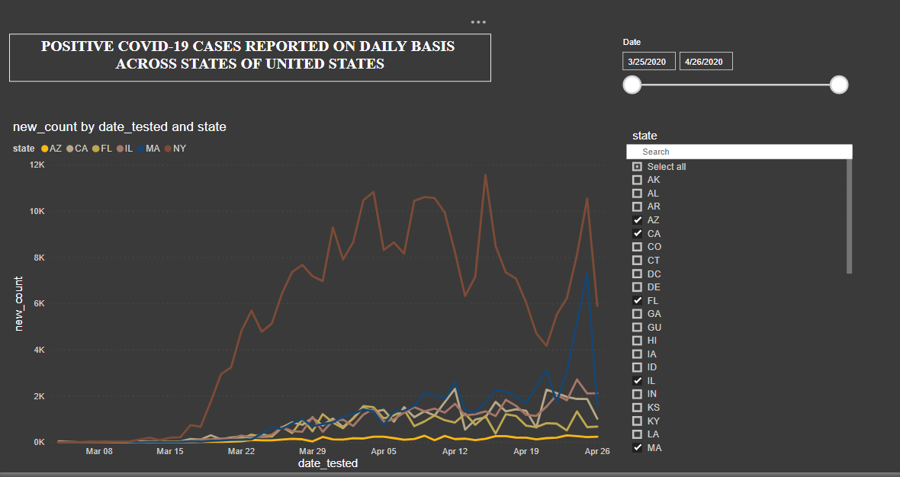
Dashboard for Story 1

Slide 13
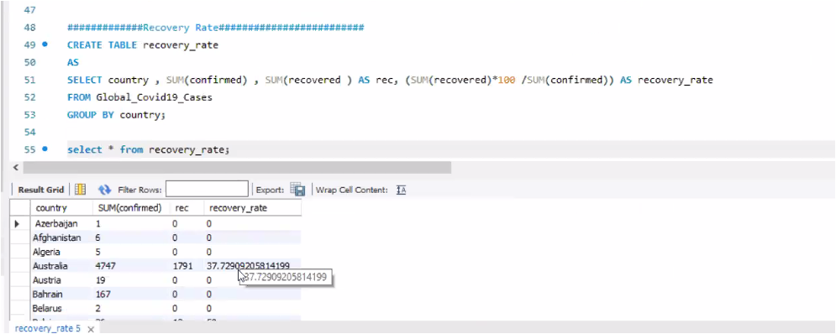
Story 2: Covid-19 recovery rate across all the countries around the world
SQL query : Calculating recovery rate across countries.

Slide 14
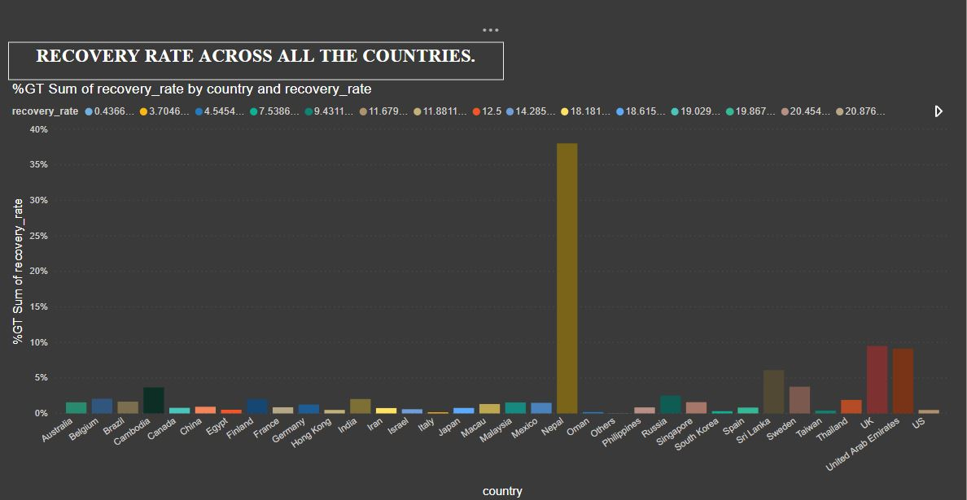
Dashboard for story 2:

Slide 15
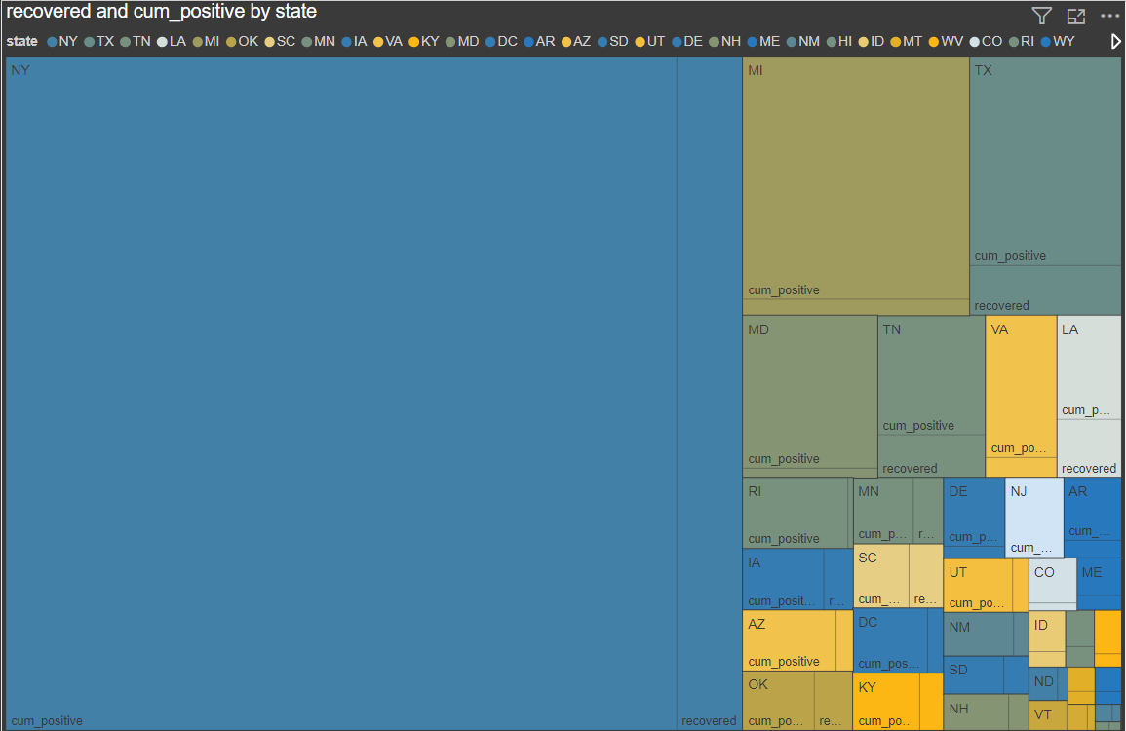

Slide 16
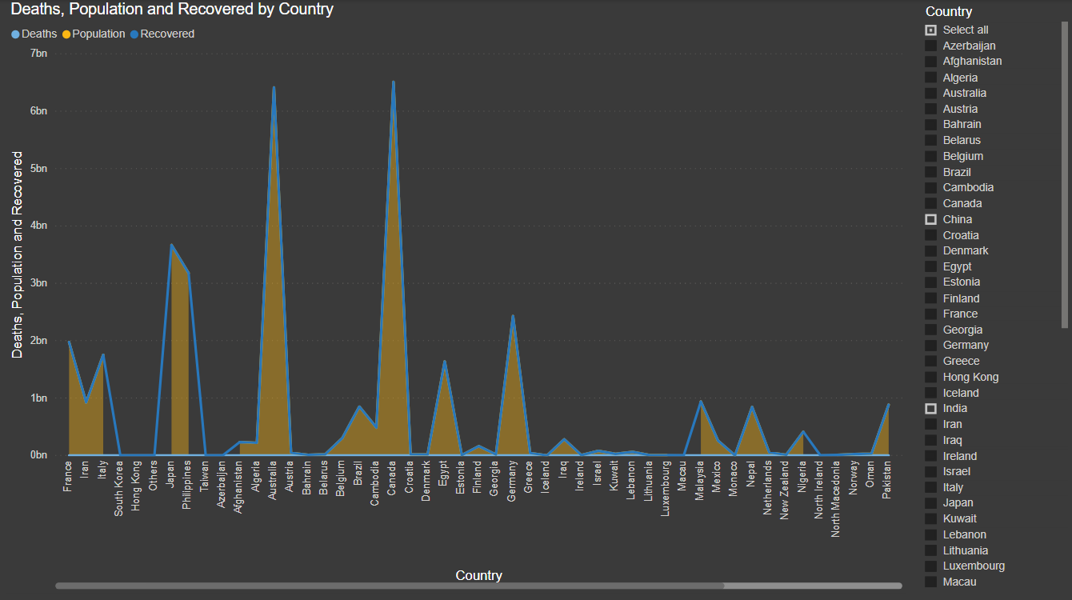

Slide 17
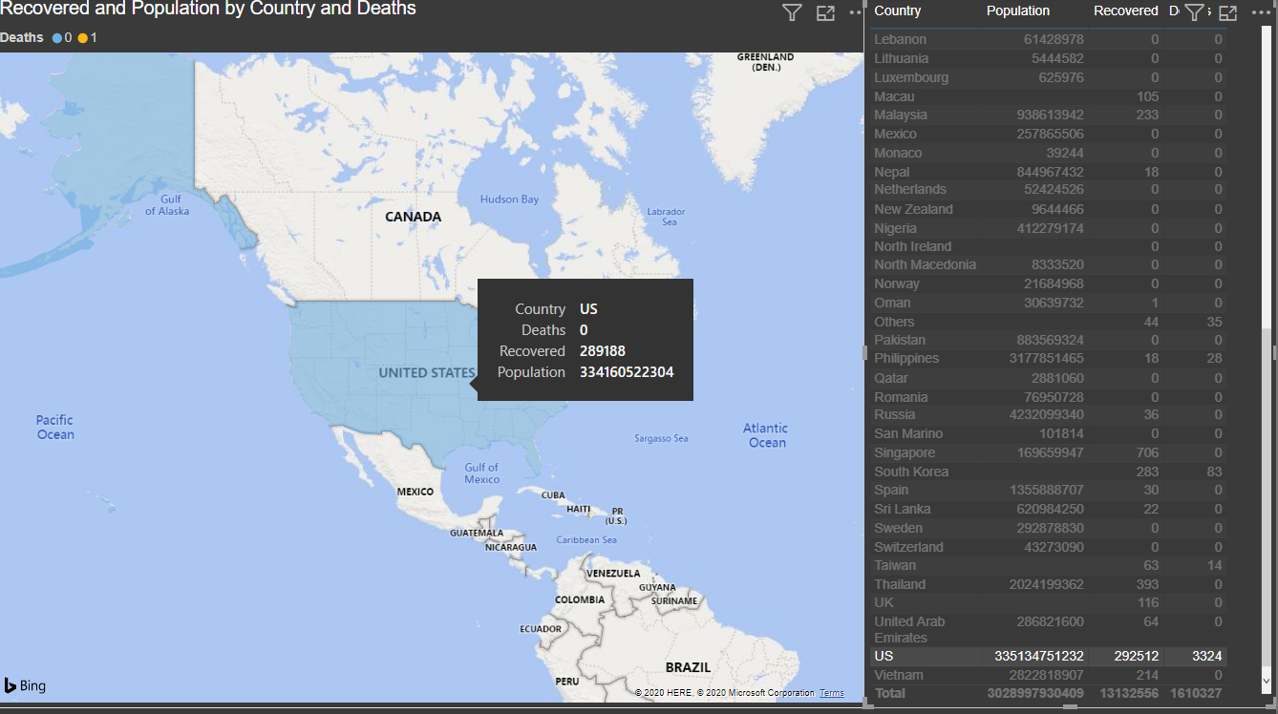
SHOWING DATA OF SPECIFIC COUNTRY - USA

Slide 18
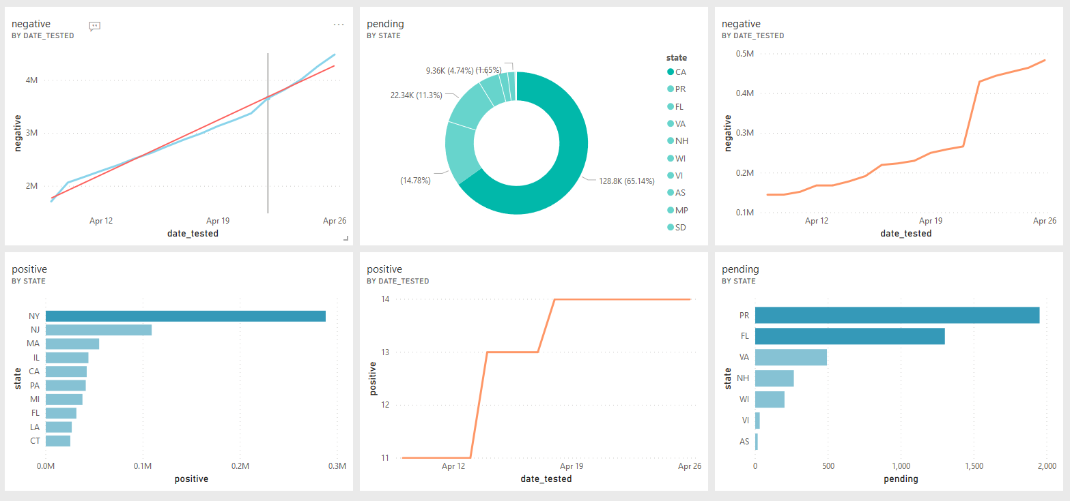
PENDING TESTING, NEGATIVE, POSITIVE CASES ACROSS THE STATES OF USA

Slide 19





The Team - Technocratic Dynamos
Ankit Patil
Divya Poojari
Neha Desai
Daphney Carol V
Tanmay Patil

